Slide 1

DOCUMENT UTILITY
Project guide :ROHINI MAM
Team members : BATCHU SRIHASA JYOTHSNA [18JG1A0509]
GANAGALLA PRIYAVARSHINI [18JG1A0526]
KARRI SADAA NAVYA SRIJA[18JG1A0543]
KONDALA SRAVANI [18JG1A0551]

Slide 2
ABSTRACT
OBJECTIVE :
" Document Utility" is the project mainly for college institute and students, where the institute facilities student's certificate through online.
We are going to create an application which will be available in the college website to apply for certificates.
Coming to front end we are using “HTML" and °CSS" and "hyperlinks" to create an application and to reach the message to the user.
Coming to backend after getting the necessary information, we have to check either the data is present in system database or not “PostgreSQL 13.0.1”
and pgAdmin v4.0.6

Slide 3
WHAT IS DJANGO?
Django is a framework for building a fully functioning web application.
Django web framework is written on quick and powerful python language.
It is a high-level, MVC-style, open-source collection of libraries.
Data modelled with python classes.
Elegant system for mapping URLs to python code.
Django is a powerful template language.

Slide 4
REQUIREMENTS
SOFTWARE:
HARDWARE:

Slide 5
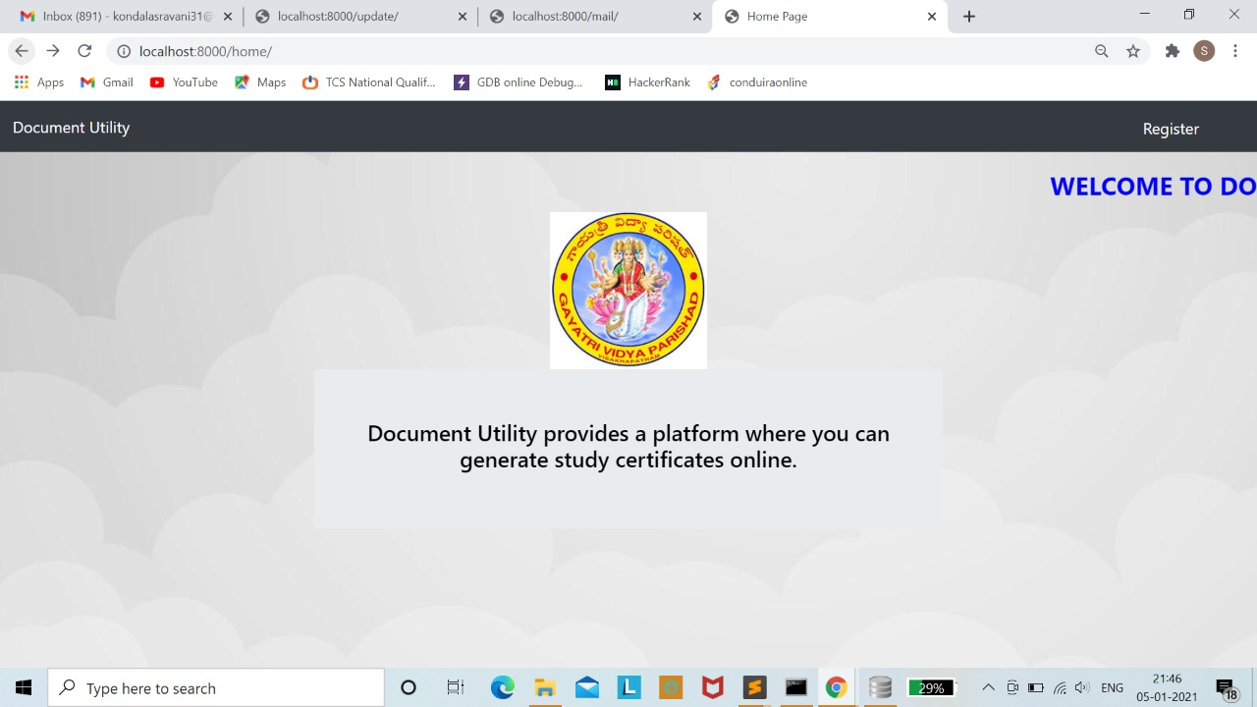
Here comes the main page of our project
Here we need to register to collect our certificate

Slide 6
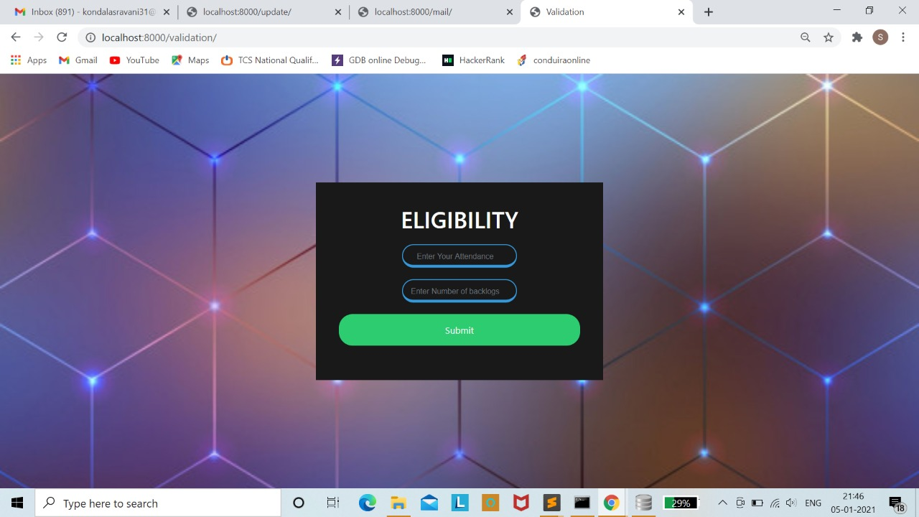
After tapping the REGISTER button we loaded to the page of Eligibility criteria
This Eligibility criteria is based on attendance percentage and number of backlogs

Slide 7
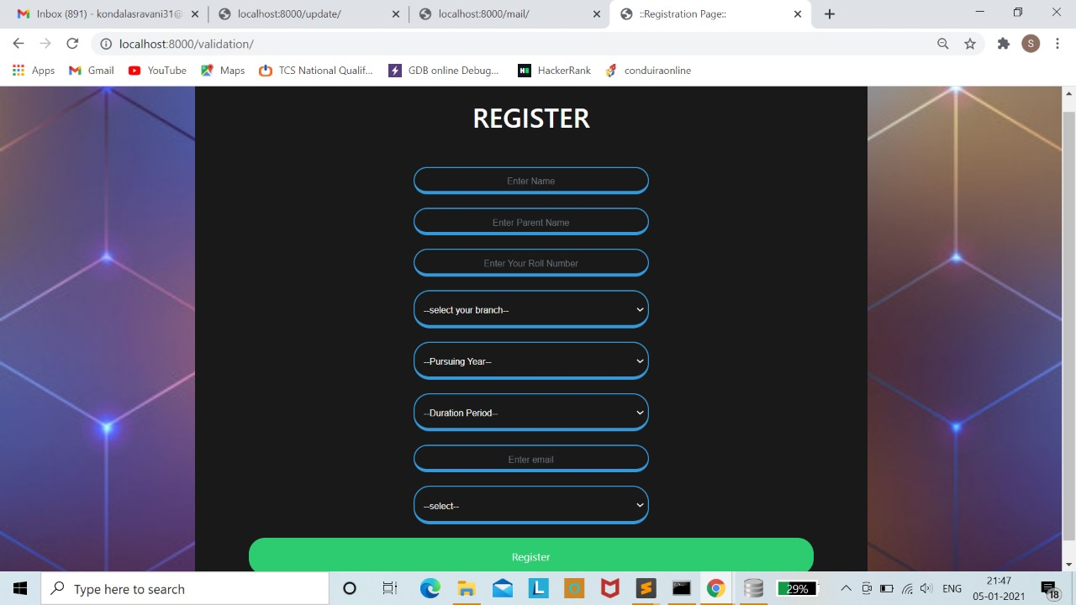
Here student need to fill the information which is required for his/her certification
After filling you can click on REGISTER button to submit the details

Slide 8
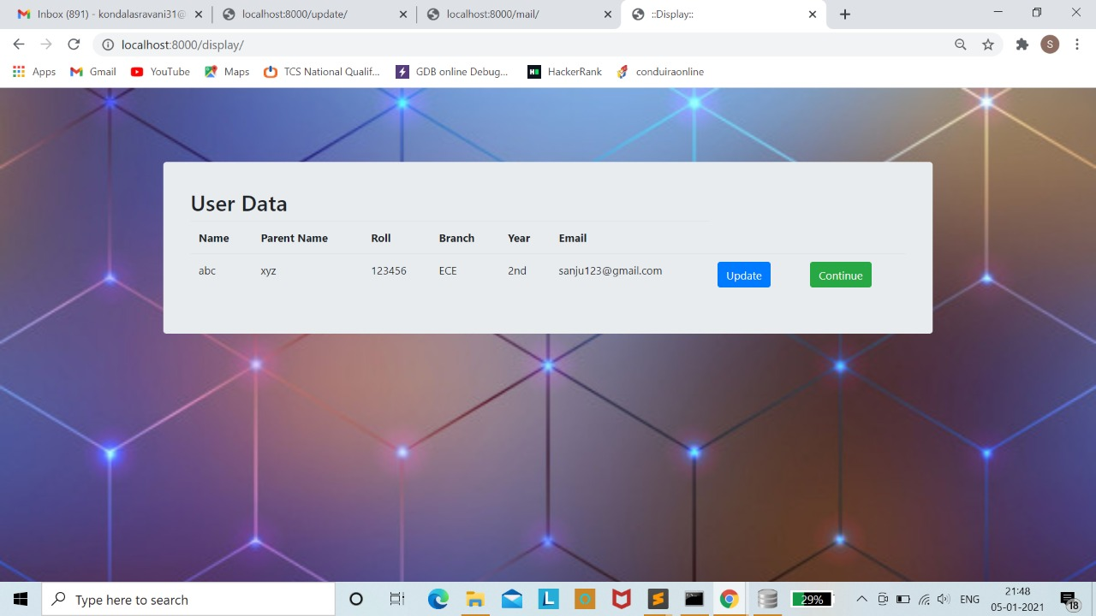
After submitting ,this dialog box appear with the information which you had given in the previous page
Here In this page u can see two buttons naming “UPDATE” and “CONTINUE”
Here UPDATE button is for making changes in data which is given in previous page

Slide 9
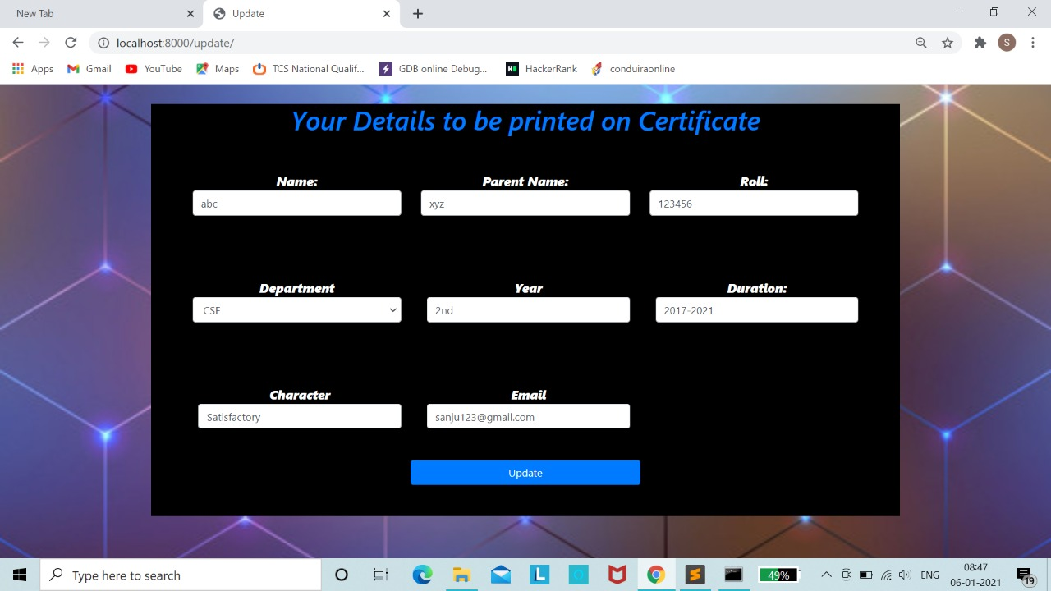
This is the page which appears after tapping on UPDATE button and here you can make changes and then press on update to save the changes done

Slide 10
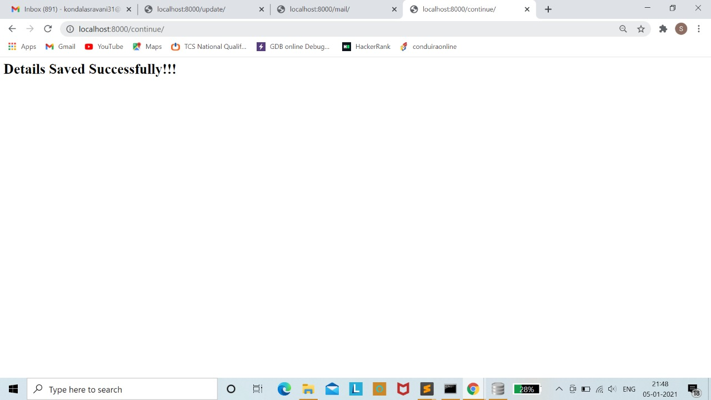
Here after updating the changes and finally it appears ”Details Saved Successfully”
This means that you will be getting certificate for your mail as pdf

Slide 11
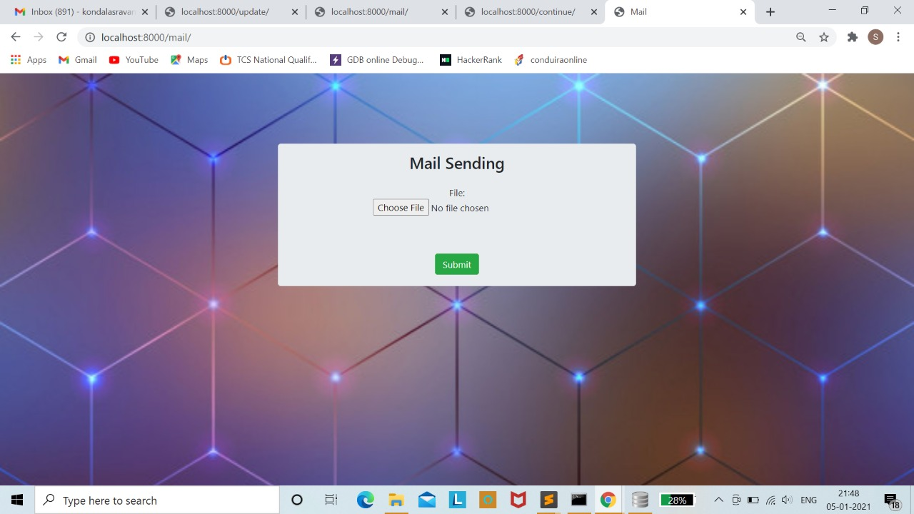
This is the process which is done at backend
we need to check the “ pgAdmin “ and then choose the file and send it

Slide 12
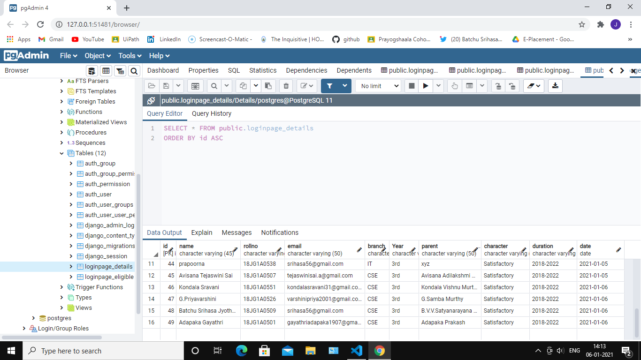
This is the pgAdmin where the details stored which is given by student

Slide 13
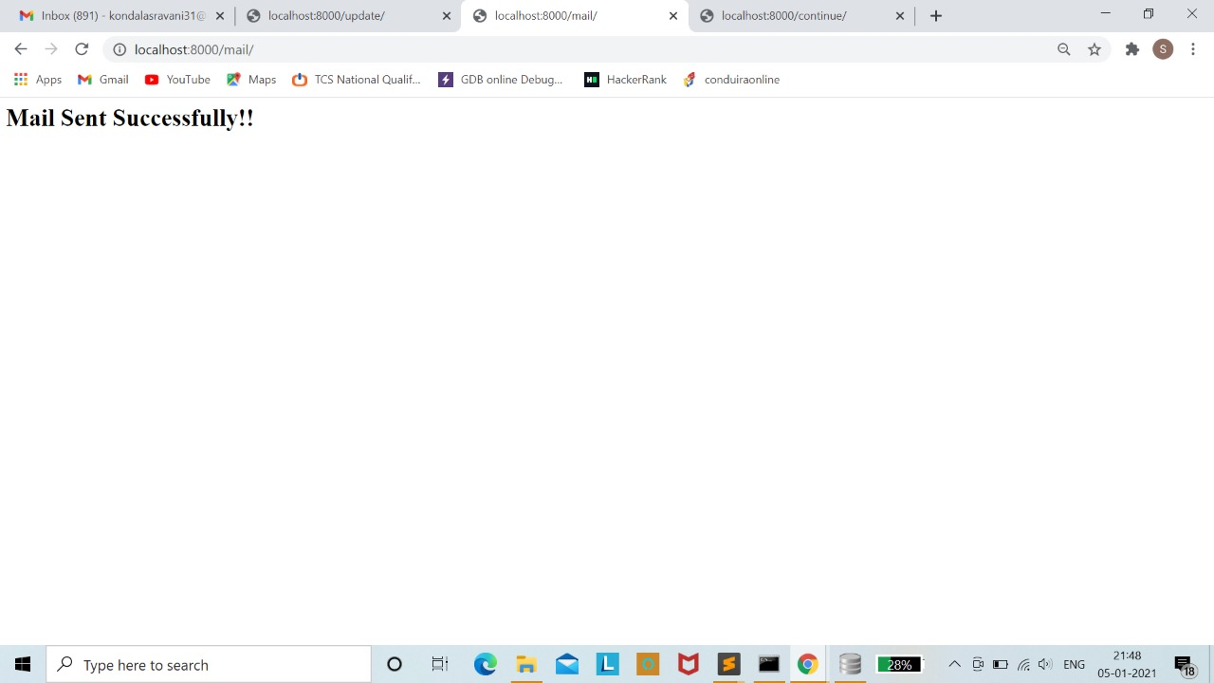
This page conforns that the mail is sent to particular recipient successfully

Slide 14
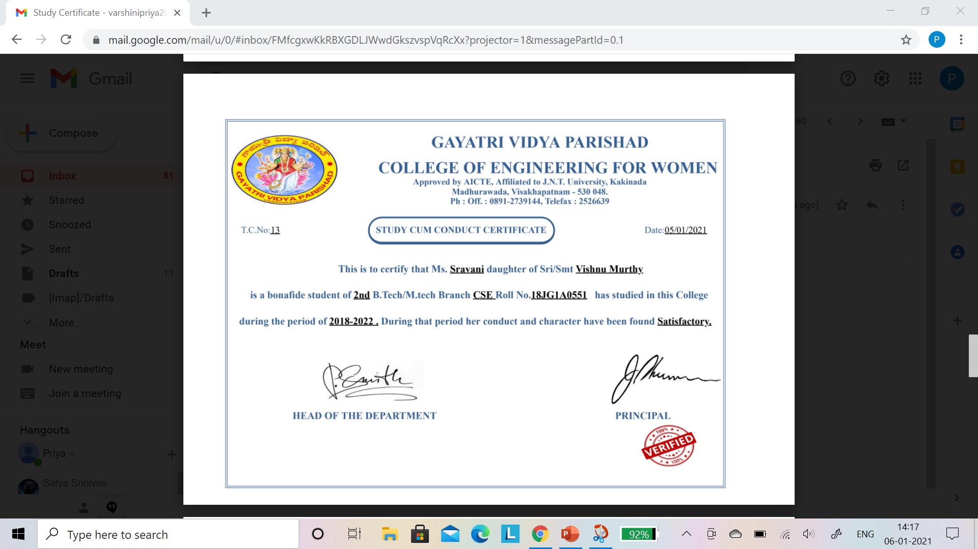
In this way the “STUDY CERTIFICATE ”is sent to the particular recipient

Slide 15
scope
Multi-Lingual support.
Object-Relational Mapper
Tight Integration between components.
Automatic Administration Interface

Slide 16
CONCLUSION

